Slide 1
Project Description

Slide 2
Process Flow

Slide 3
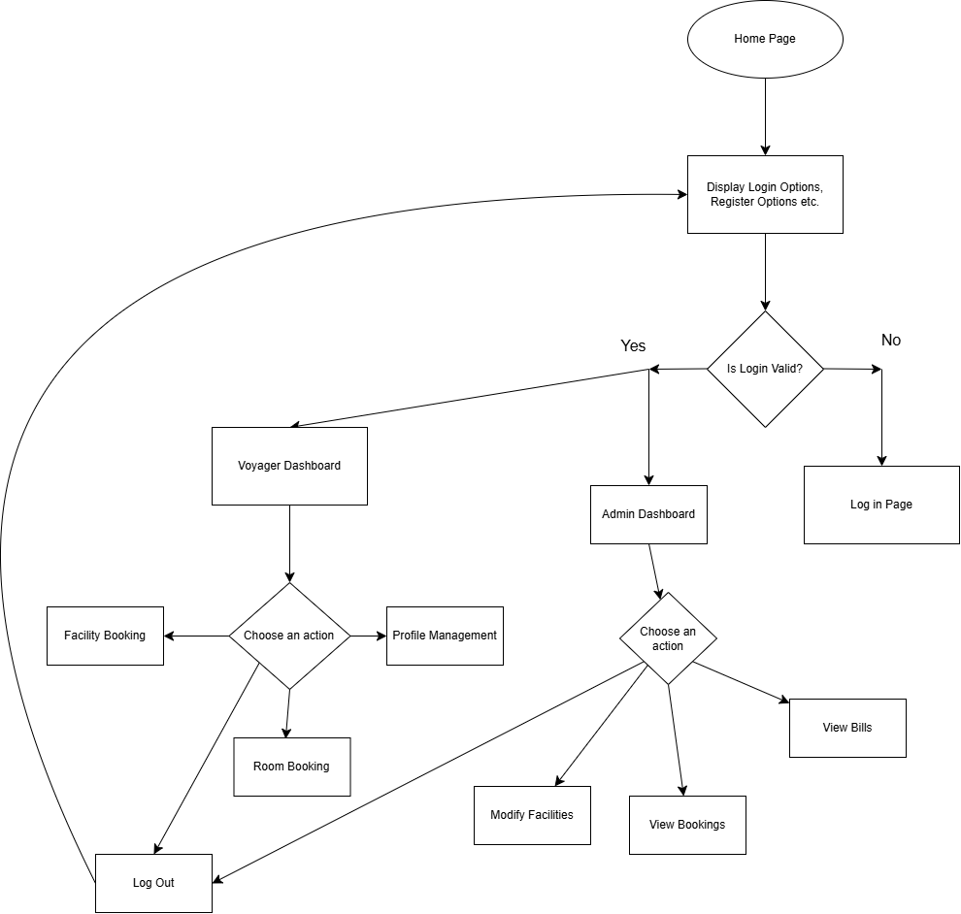

Slide 4
Entity Relation Diagram

Slide 5
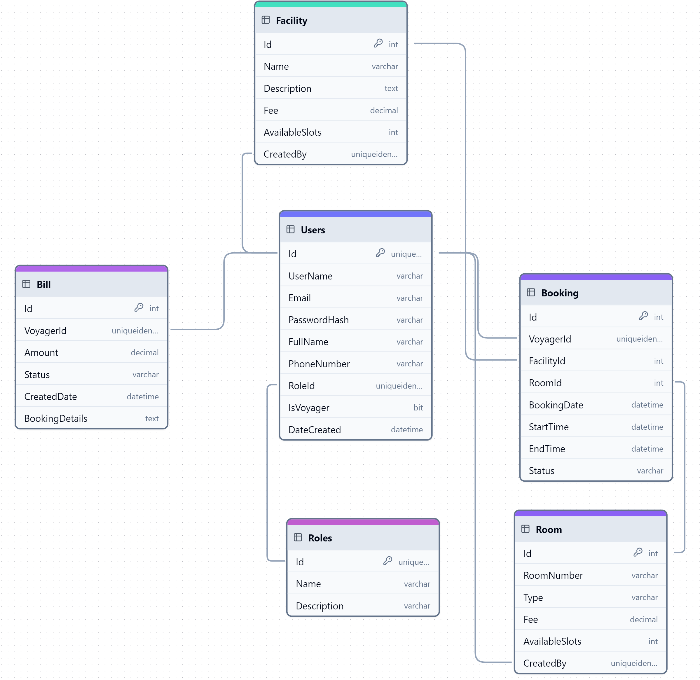

Slide 6
Wireframe

Slide 7
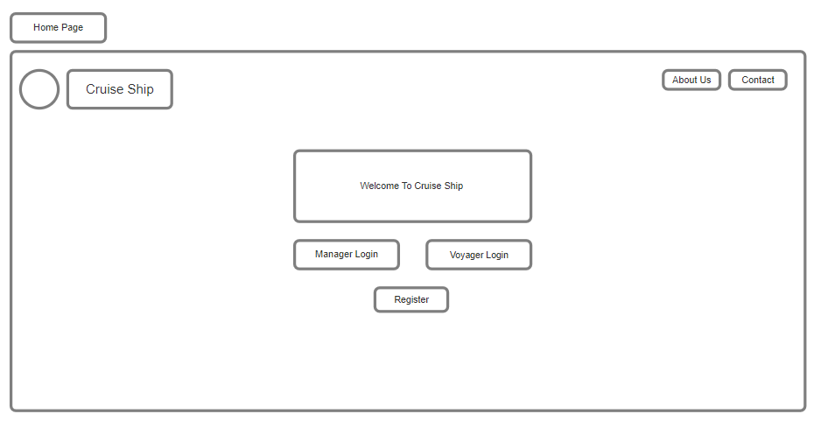

Slide 8
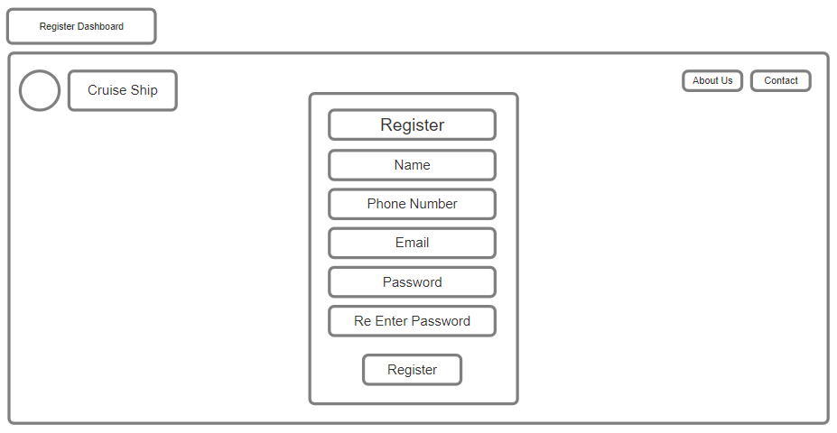

Slide 9
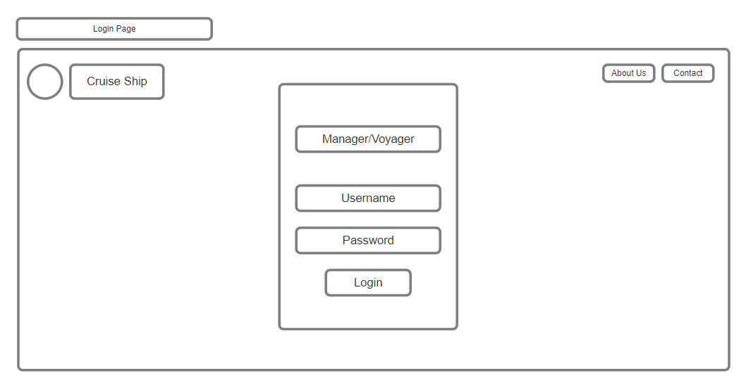

Slide 10
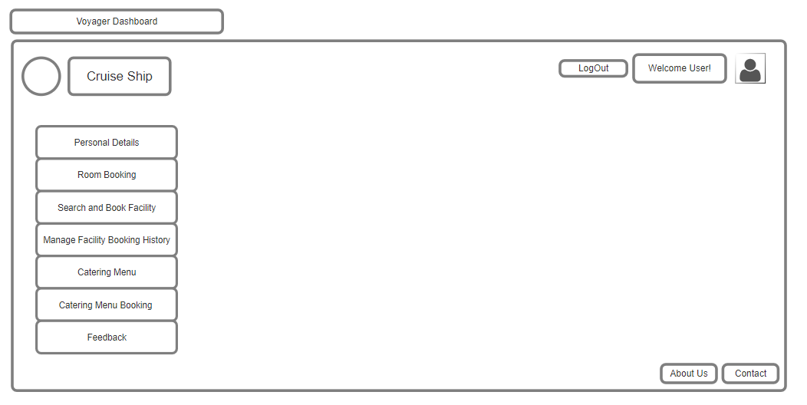

Slide 11
